Slide 1
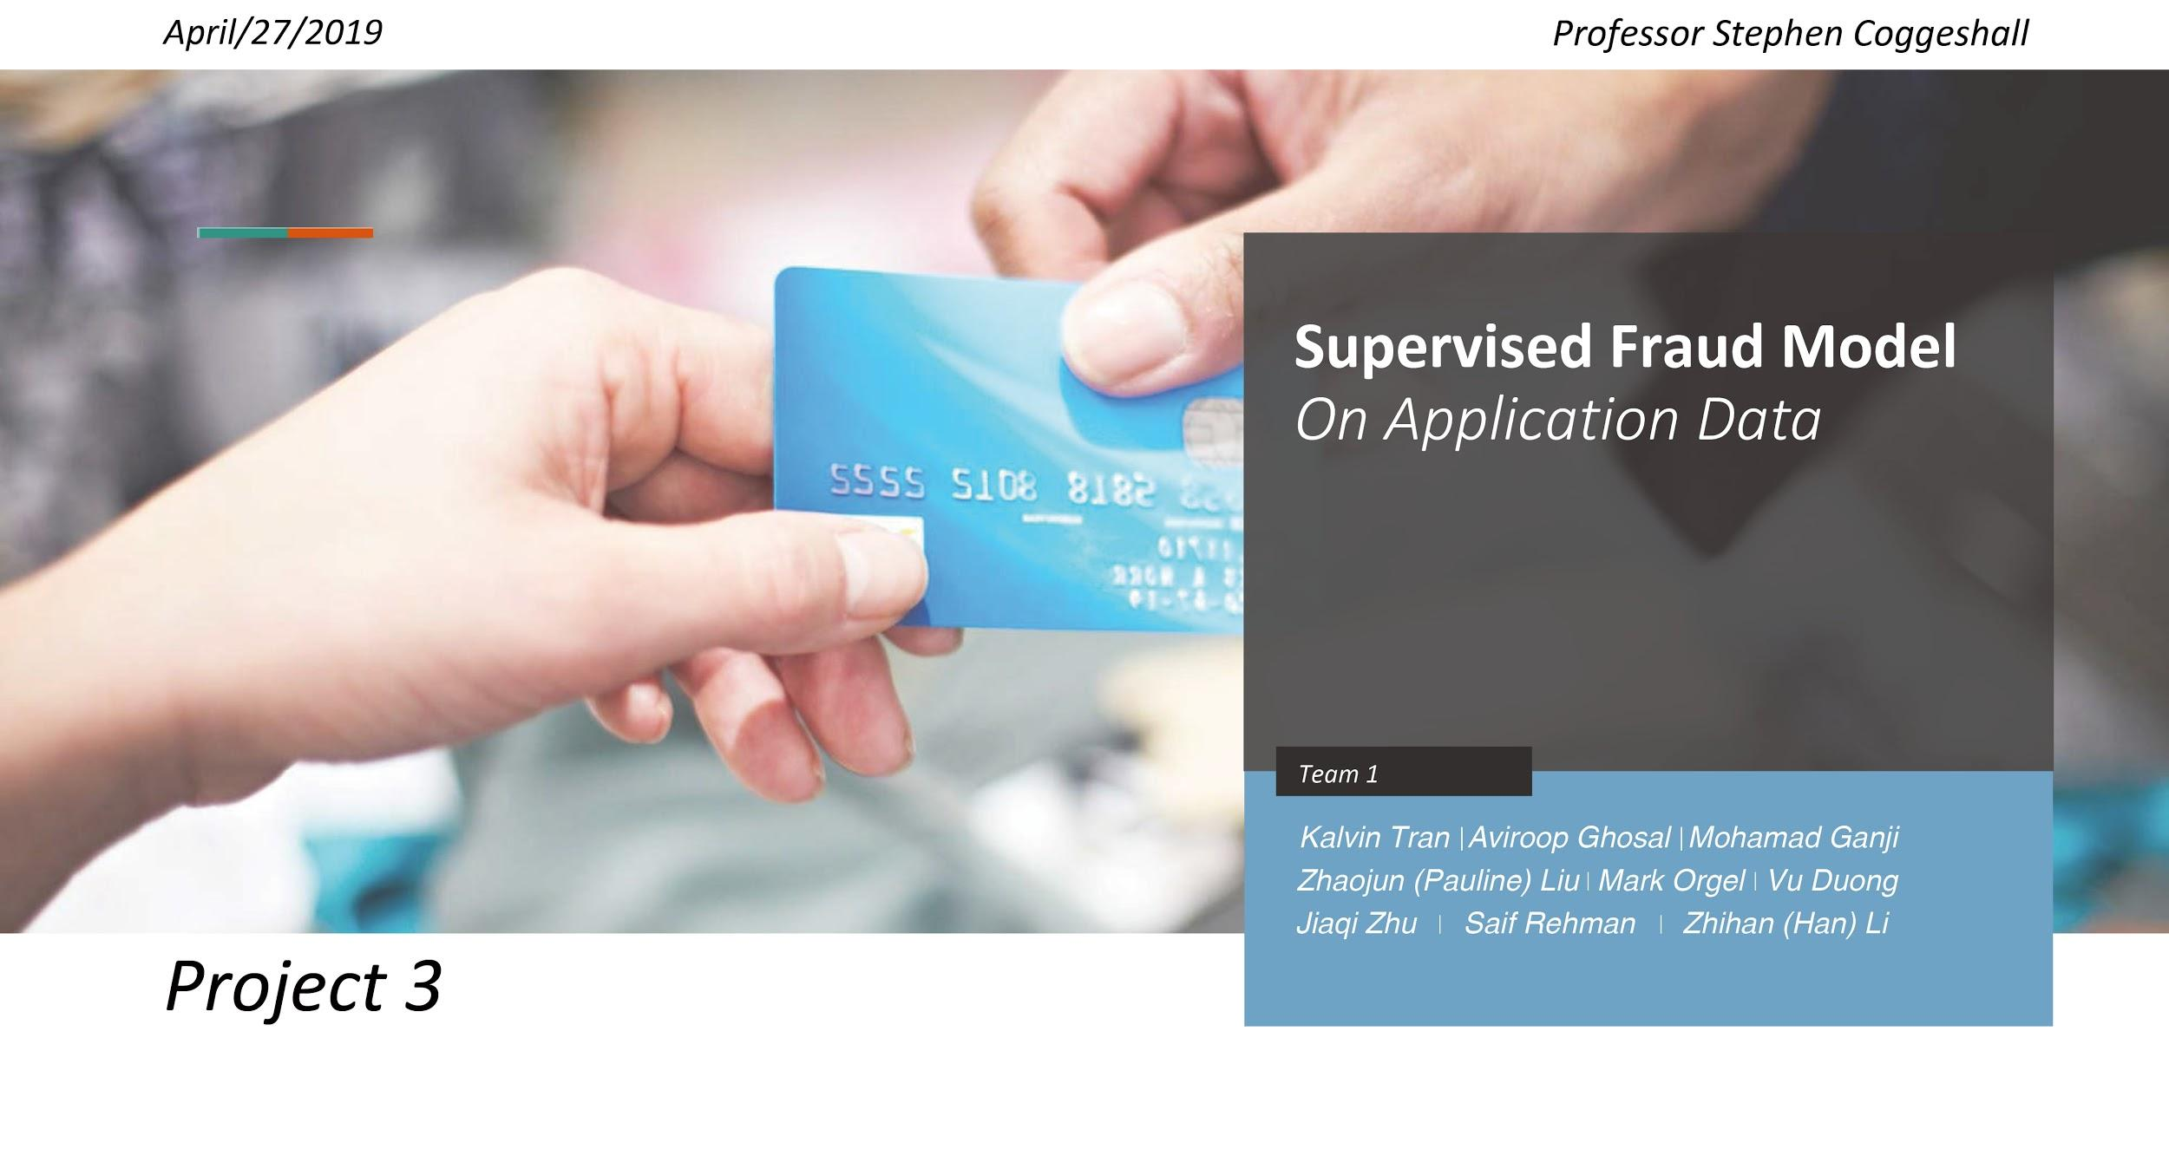

Slide 2
Outline
1. Define The Problem
2. Description of Data
3. Data Cleaning & Candidate Variables
4. Feature Selection
5. Modeling
6. Business Interpretation
7. Executive Summary
Notes:
1. talk about problems and briefly introduce how to solve problem
2. data intro
3.data cleaning
4.variable creation
5.feature selection
6. models
7. performance, especially how we help our clients (like save money)
8. conclusion and how to improve performance in the future

Slide 3
The Fraud Problem

Slide 4
In 2016, we had 1M applications, generating $49M
However...

Slide 5
We had a net loss of $37M
What happened?

Slide 6
We had a net loss of $37M
Out of 1M applications,
14,393 were fraudulent
At $50 per good application, we generated $49M in revenue
However, each fraud cost us $6,000, resulting in a loss of $86M

Slide 7
We had a net loss of $37M
Out of 1M applications,
14,393 were fraudulent
At $50 per good application, we generated $49M in revenue
However, each fraud cost us $6,000, resulting in a loss of $86M
So, whats the fix?

Slide 8
Reduce the number of frauds we accept
Develop model to score applications for how likely they are to be fraudulent and provide a guiding policy
Minimize the number of frauds, which cost us $6,000 per fraud
Minimize our opportunity cost, which cost us $50 per good application

Slide 9
2. Description of Data

Slide 10
Application Data
Field | Records | Unique Values | Most Common Entry | Count of Entry | Percentage of Total
Recnum | 1,000,000 | 1,000,000 | N/A | N/A | N/A
Date | 1,000,000 | 365 | 20160816 | 2,877 | 0.29%
Ssn | 1,000,000 | 835,819 | 999999999 | 16,935 | 1.69%
Firstname | 1,000,000 | 78,136 | EAMSTRMT | 12,658 | 1.27%
Lastname | 1,000,000 | 177,001 | ERJSAXA | 8,580 | 0.86%
Address | 1,000,000 | 828,774 | 123 MAIN ST | 1,079 | 0.11%
Zip5 | 1,000,000 | 26,370 | 68138 | 823 | 0.08%
Dob | 1,000,000 | 43,673 | 19070626 | 126,568 | 12.66%
Homephone | 1,000,000 | 28,244 | 9999999999 | 78,512 | 7.85%
Fraud | 1,000,000 | 2 | 0 | 985,607 | 98.56%
Notes:
Date of Records: 1/1/2016 - 12/31/2016
Total Records: 1,000,000
Total Number of Fields: 10 Categorical Fields
Source: Professor Stephen Coggeshall

Slide 11
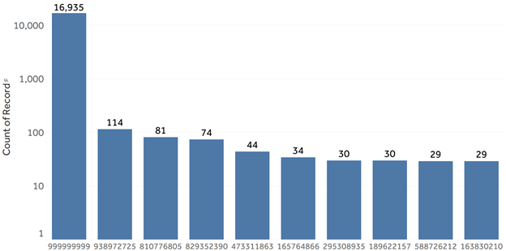
Social Security Number (SSN)

Slide 12
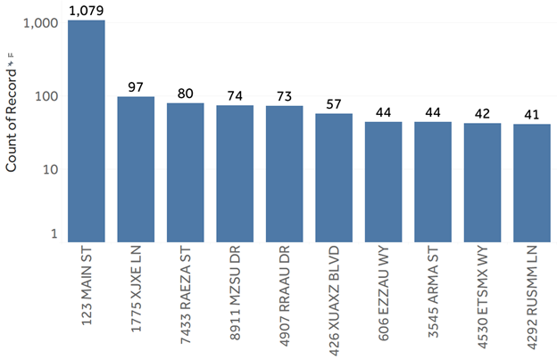
Address

Slide 13
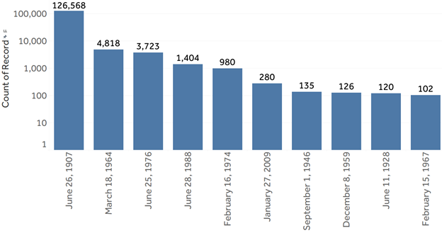
Date of Birth

Slide 14
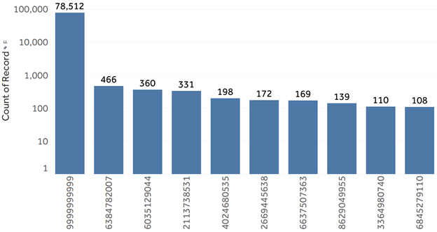
Home Phone Number (Homephone)

Slide 15
3. Data Cleaning & Candidate Variables

Slide 16
Cleaning Data & Frivolous Values
Field | # records with value Zero and Null
Recnum | 0
Date | 0
Ssn | 0
Firstname | 0
Lastname | 0
Address | 0
Zip5 | 0
Dob | 0
Homephone | 0
Fraud | 0
Field | Frivolous Value
Ssn | 999999999
Address | 123 MAIN ST
Homephone | 9999999999
DoB | 19070626

Slide 17
Variable Creation
9 New Variables from fraud score, fulladdress & namedob
6 New Variables from Days since (Single entity)
48 New Variables from Record Count (Single entity)
8 New Variables from Days since (Combined 2 entities)
64 New Variables from Record Count (Combined 2 entities)
224 New Variables from Record Count ratios (Combined 2 entities)
4 New Variables from Risk Table
363 New Variables Created

Slide 18
4. Feature Selection

Slide 19
Feature Selection
Initial Data
Filter Method
Wrapper Method
Started with 363 crafted features
Utilized the Kolmogrov-Smirnov (KS) and the Fraud Detection Rate (FDR) to pick the top 159 variables
Employed cross-validated recursive feature elimination (RFEcv) to obtain the top 25 variables

Slide 20
5. Modeling
Logistic Regression
Decision Tree
Random Forest
Ada Boost
Gradient Boosting
Neural Network

Slide 21
5. Modeling - Performance Table

Slide 22
MODEL | Parameter |  |  |  | Average FDR (%) at 3%
Logistic Regression | Max Iteration |  | Penalty |  | TRAIN | TEST | OOT
1 | 100 |  | L2 |  | 48.29 | 48.78 | 46.1
2 | 200 |  | L1 |  | 48.63 | 49.06 | 46.35
Decision Tree | Max Depth |  | Min_samples_leaf |  | TRAIN | TEST | OOT
1 | None |  | 1 |  | 86.96 | 46.11 | 43.59
2 | 10 |  | 1 |  | 52.89 | 51.89 | 50.29
3 | 12 |  | 30 |  | 53.56 | 53.0 | 51.93
Random Forest | # of Trees | Max Depth |  | Mini_sample_leaf | TRAIN | TEST | OOT
1 | 500 | 10 |  | 20 | 54.6 | 54.16 | 51.51
2 | 700 | 10 |  | 1 | 54.6 | 54.08 | 51.47
3 | 700 | 15 |  | 1 | 58.19 | 55.14 | 52.18
AdaBoost | # of Trees |  | Learning Rate |  | TRAIN | TEST | OOT
1 | 100 |  | 0.5 |  | 51.7 | 51.78 | 49.66
2 | 150 |  | 0.5 |  | 51.89 | 52.33 | 50.08
Gradient Boosting | # of Trees |  | Max Depth |  |  | TEST | OOT
1 | 250 |  | 5 |  | 58.85 | 55.5 | 53.27
2 | 200 |  | 5 |  | 58.36 | 55.66 | 53.35
MLP | Activation | Solver |  | Learning Rate | TRAIN | TEST | OOT
1 | relu | adam |  | 0.001 | 52.29 | 52.47 | 50.29
2 | logistic | adam |  | 0.001 | 52.83 | 52.94 | 50.71

Slide 23
5. Modeling -
Table Statistics

Slide 24
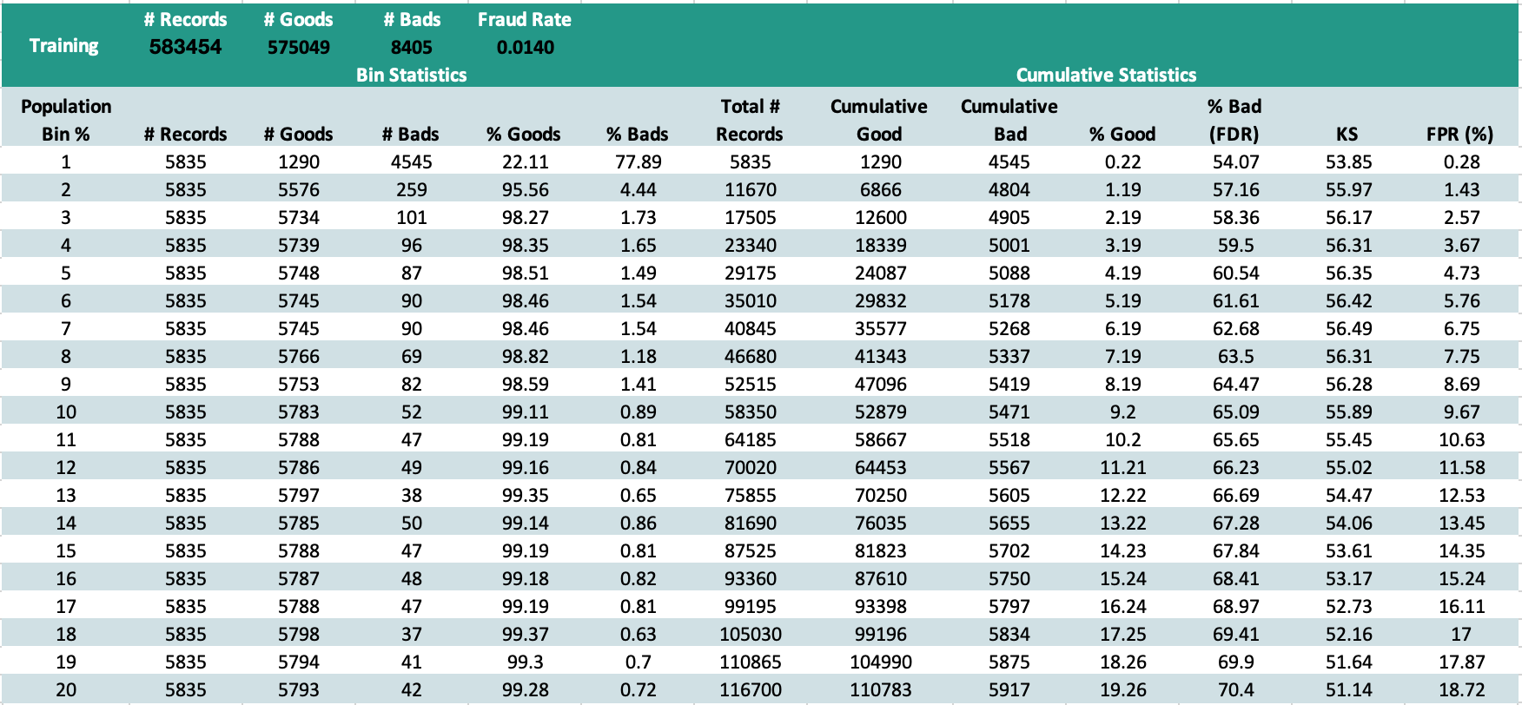

Slide 25
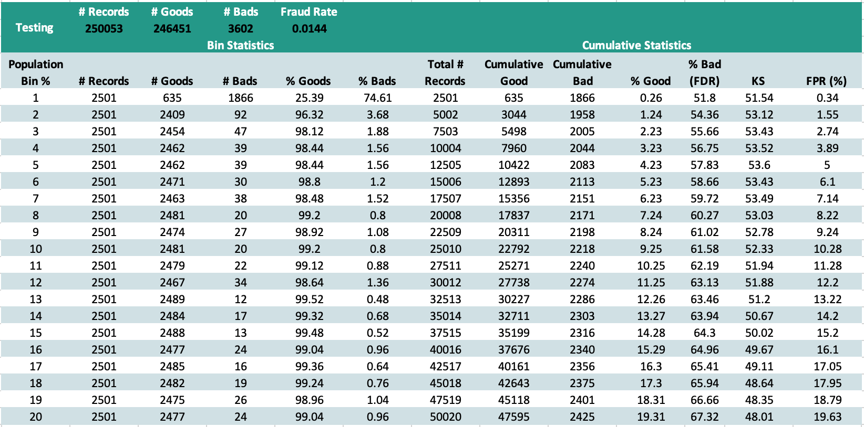

Slide 26
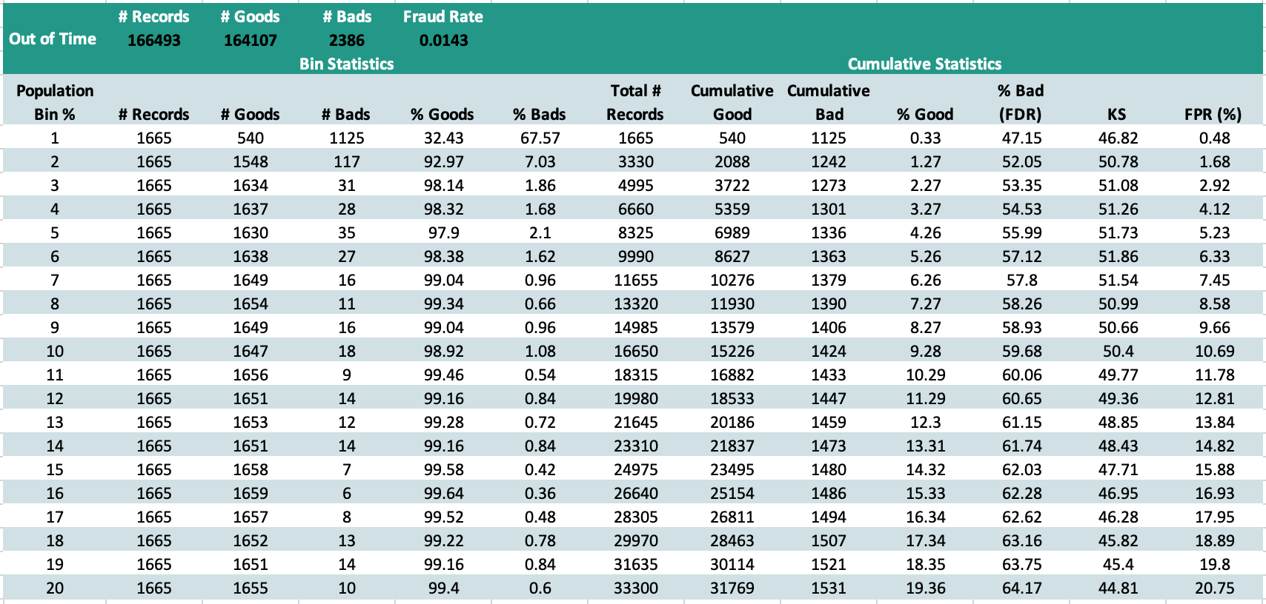

Slide 27
6. Business Interpretation -
Fraud Savings

Slide 28
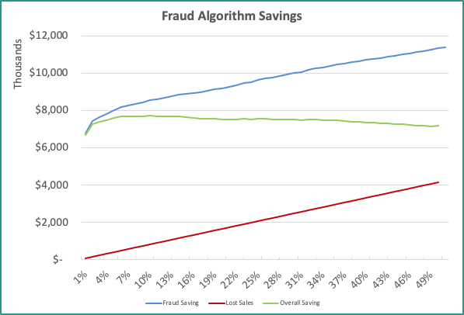

Slide 29
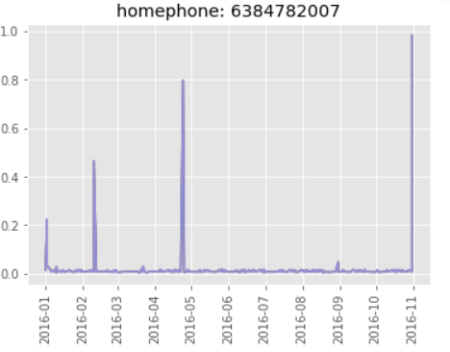
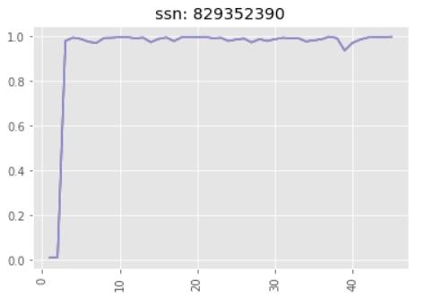
6. Business Interpretation
Fraud score

Slide 30
7. Executive Summary

Slide 31
Using our model would have saved nearly $8 million in the last 2 months of 2016
1,000,000 past applications with 8 fields and a fraud label
363 New Variables were created
25 Variables were chosen through feature selection
14 Models were created using 6 different methods
>50% of frauds eliminated by rejecting <2% of applications
$7.8 million maximized savings by rejecting only 10%
$1.7 million in profit instead of a $6.1 million loss

